Slide 1
LECTURE # 10
ORDERED PAIR
  An ordered pair (a, b) consists of two elements “a” and “b” in which “a” is the first element and “b” is the second element.
  The ordered pairs (a, b) and (c, d) are equal if, and only if, a = c and b = d.
  Note that (a, b) and (b, a) are not equal unless a = b.

Slide 2
EXERCISE
  Find x and y given (2x, x + y) = (6, 2)
  SOLUTION:
  2x = 6 ………………(1)
  and x + y = 2 ……………..(2)
  Solving equation (1) we get x = 3 and when substituted in (2) we get y = -1.

Slide 3
ORDERED n-TUPLE
  The ordered n-tuple, (a₁, a₂, …, a_{n}) consists of elements a₁, a₂, ..a_{n} together with the ordering: first a₁, second a₂, and so forth up to a_{n}.
  In particular, an ordered 2-tuple is called an ordered pair, and an ordered 3-tuple is called an ordered triplet.
  Two ordered n-tuples (a₁, a₂, …, a_{n}) and (b₁, b₂, …, b_{n}) are equal if and only if each corresponding pair of their elements is equal, i.e., a_{i} = b_{i}, for all i = 1, 2, …, n.

Slide 4
CARTESIAN PRODUCT OF TWO SETS
  Let A and B be sets. The Cartesian product of A and B, denoted A × B (read “A cross B”) is the set of all ordered pairs (a, b), where a is in A and b is in B.
  Symbolically:
  A ×B = {(a, b)| a ∈ A and b ∈ B}
  NOTE
  If set A has m elements and set B has n elements then A ×B has m × n elements.

Slide 5
EXAMPLE:
Let A = {1, 2}, B = {a,b, c} then
A ×B = {(1,a), (1,b), (1,c), (2,a), (2, b), (2, c)}
B ×A = {(a,1), (a,2), (b, 1), (b, 2), (c, 1), (c, 2)}
A ×A = {(1, 1), (1,2), (2, 1), (2, 2)}
B ×B = {(a,a), (a,b), (a,c), (b,a), (b, b), (b, c), (c,a), (c,b),(c,c)}

Slide 6
  REMARK:
  Cartesian product is Not commutative.
  A × B ≠ B × A for non-empty and unequal sets A and B.
  A × φ = φ × A = φ
  | A × B| = |A| × |B|
  The third remark says that the number of elements in the Cartesian product is equal to the product of the number f elements in the sets.

Slide 7
CARTESIAN PRODUCT OF MORE THAN TWO SETS
  The Cartesian product of sets A₁, A₂, …, A_{n}, denoted
  A₁× A₂ × … ×A_{n,} is the set of all ordered n-tuples (a₁, a₂, …, a_{n})
  where a₁ ∈A₁, a₂ ∈A₂,…, a_{n} ∈A_{n.}
  Symbolically:
  A₁× A₂ × … ×A_{n}={(a₁, a₂, …, a_{n}) | a_{i} ∈A_{i}, for i=1, 2, …, n}

Slide 8
EXAMPLE
  Let A = {1, 2}, B = {a, b, c}, C = {x, y}, then
  A × B × C = {(1, a, x), (1, a, y), (1, b, x), (1, b, y), (1, c, x), (1, c, y), (2, a, x), (2, a, y),(2, b, x), (2, b, y), (2, c, x), (2, c, y) }
  Also (A × B) × C = {(u, v) | u ∈ A × B and v ∈ C}
  Now A × B = {(1, a), (1, b), (1, c), (2, a), (2, b), (2, c)}
  and (A × B) × C ={((1, a), x), ((1, a), y), ((1, b), x) ,((1, b), y), ((1, c), x), ((1, c), y), ((2, a), x),((2, a), y),
  ((2, b), x), ((2, b), y), ((2, c), x),
  ((2, c), y) }

Slide 9
  Note that A × B × C and (A × B) × C are entirely different sets and you can also see that
  (A × B) × C ≠ A × ( B × C)

Slide 10
BINARY RELATION
  Let A and B be sets. A (binary) relation R from A to B is a subset of
  A × B.
  When (a, b) ∈R, we say a is related to b by R, written a R b.
  Otherwise if (a, b) ∉R, we write
  a R b.
  a R b means that a is not related to b by R.

Slide 11
  EXAMPLE: Let A = {1, 2}, B = {1, 2, 3}
  Then A × B = {(1, 1), (1, 2), (1, 3), (2, 1), (2, 2), (2, 3)}
  Let R₁={(1,1), (1, 3), (2, 2)}
  R₂={(1, 2), (2, 1), (2, 2), (2, 3)}
  R₃={(1, 1)}
  R₄= A × B
  R₅= ∅
  All being subsets of A × B are relations from A to B.

Slide 12
DOMAIN OF A RELATION
  The domain of a relation R from A to B is the set of all first elements of the ordered pairs which belong to R denoted Dom(R)
  Symbolically:
  Dom (R) = {a ∈A| (a,b) ∈R}

Slide 13
RANGE OF A RELATION
  The range of A relation R from A to B is the set of all second elements of the ordered pairs which belong to R denoted Ran(R).
  Symbolically:
  Ran(R) = {b ∈B|(a,b) ∈ R}
  NOTE
  The domain of a relation from A to B is a subset of A, and its range is a subset of B.

Slide 14
EXERCISE
  Let A = {1, 2}, B = {1, 2, 3},
  Define a binary relation R from A to B as follows:
  R = {(a, b) ∈A × B | a < b}
  Then
  Find the ordered pairs in R.
  Find the Domain and Range of R.
  Is 1R3, 2R2?

Slide 15
SOLUTION
  Given A = {1, 2}, B = {1, 2, 3},
  A × B = {(1,1), (1,2), (1,3), (2,1), (2,2), (2,3)}
  Find the ordered pairs in R.
  R = {(a, b) ∈A × B | a < b}
  R = {(1,2), (1,3), (2,3)}
  Find the Domain and Range of R.
  Dom(R) = {1,2} and
  Ran(R) = {2, 3}
  Is 1R3, 2R2?
  Since (1,3) ∈R so 1R3
  But (2, 2) ∉R so 2R3

Slide 16
EXAMPLE
  Let A = {eggs, milk, corn} and B = {cows, goats, hens}
  Define a relation R from A to B by (a, b) ∈R iff a is produced by b.
  Then R = {(eggs, hens), (milk, cows), (milk, goats)}
  Thus, with respect to this relation
  eggs R hens, milk R hens.
  milk R cows, corn R goats etc.

Slide 17
EXERCISE
  Find all binary relations from {0,1} to {1}
  SOLUTION: Let A = {0,1}
  B = {1}
  Then A × B = {(0,1), (1,1)}
  All binary relations from A to B are in fact all subsets of A × B, which are:
        R₁= ∅
        R₂={(0,1)}
        R₃={(1,1)}
        R₄={(0,1), (1,1)} = A × B

Slide 18
REMARK
  If |A| = m and |B| = n
  Then as we know that the number of elements in A × B are m × n.
  and the total number of relations from A to B are 2^{m × n}.

Slide 19
RELATION ON A SET
  A relation on the set A is a relation from A to A.
  In other words, a relation on a set A is a subset of A × A.
  EXAMPLE:
  Let A = {1, 2, 3, 4}
  Define a relation R on A as
  (a,b) ∈ R iff a divides b {symbolically written as a | b}
  Then R = {(1,1), (1,2), (1,3), (1,4), (2,2), (2,4), (3,3), (4,4)}

Slide 20
  REMARK:
  For any set A
  A × A is known as the universal relation.
  2. ∅ is known as the empty relation.

Slide 21
EXERCISE
  Define a binary relation E on the set of the integers Z, as follows:
  for all m, n ∈Z, m E n ⇔ m – n is even.
  Is 0E0? Is 5E2? Is (6,6) ∈E? Is (-1,7) ∈E?
  Prove that for any even integer n, nE0.

Slide 22
  for all m, n ∈Z, m E n ⇔ m – n is even.
  SOLUTION
  E = {(m,n) ∈Z ×Z | m – n is even}
  (i) Is 0E0?
    (0,0) ∈ Z ×Z and 0-0 = 0 is even
  Therefore 0E0.
  (ii) Is 5E2?
  (5,2) ∈ Z ×Z but 5-2 = 3 is not even
  so 5 E 2

Slide 23
  Is (6,6) ∈E?
    (6,6) ∈ E since 6-6 = 0 is an even integer.
  Is (-1,7) ∈E?
    (-1,7) ∈E since (-1) – 7 = -8 is an even integer.
  Prove that for any even integer n, nE0.
  For any even integer, n, we have
  n – 0 = n, an even integer
  so (n, 0) ∈E or equivalently n E 0

Slide 24
COORDINATE DIAGRAM (GRAPH) OF A RELATION
  Let A = {1, 2, 3} and B = {x, y}
  Let R be a relation from A to B defined as
  R = {(1, y), (2, x), (2, y), (3, x)}
  The relation may be represented in a coordinate diagram as follows:
y
B
x
1
2
3
A

Slide 25
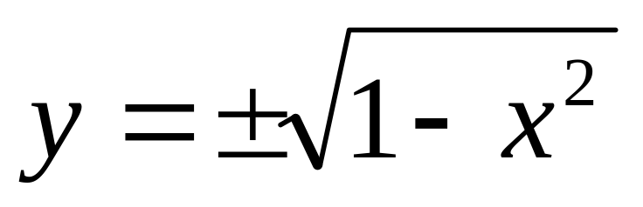
EXAMPLE
  Draw the graph of the binary relation C from R to R defined as follows:
  for all (x, y) ∈R × R,
  (x, y) ∈C ⇔ x² + y² = 1
  SOLUTION
  Clearly y is real, whenever –1 ≤ x ≤ 1
  Similarly x is real, whenever –1 ≤ y ≤ 1
  Hence the graph is limited in the range –1 ≤ x ≤ 1 and –1 ≤ y ≤ 1

Slide 26
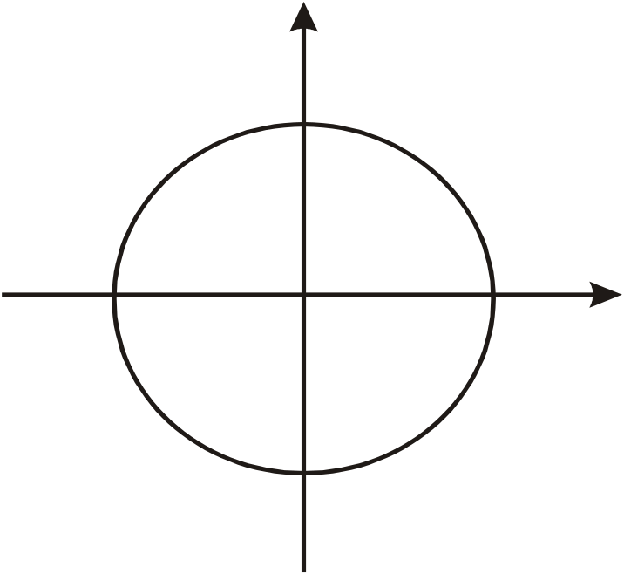
The graph of relation is
y
(0,1)
(1,0)
(-1,0)
(0,0)
(0,-1)
which is a circle with center at (0,0) & radius 1.

Slide 27

ARROW DIAGRAM OF A RELATION
  Let A = {1, 2, 3}, B = {x, y} and R = {1,y), (2,x), (2,y), (3,x)}
  be a relation from A to B.
  The arrow diagram of R is:
1
R
x
2
3
y
A
B

Slide 28
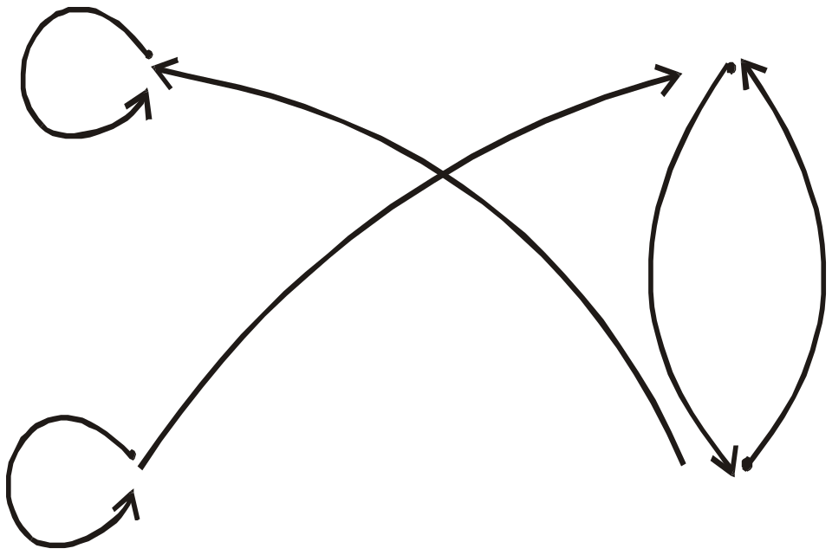
DIRECTED GRAPH OF A RELATION
  Let A = {0, 1, 2, 3}
  and R = {(0,0), (1,3), (2,1), (2,2), (3,0), (3,1)}
  be a binary relation on A.
1
0
2
3

Slide 29
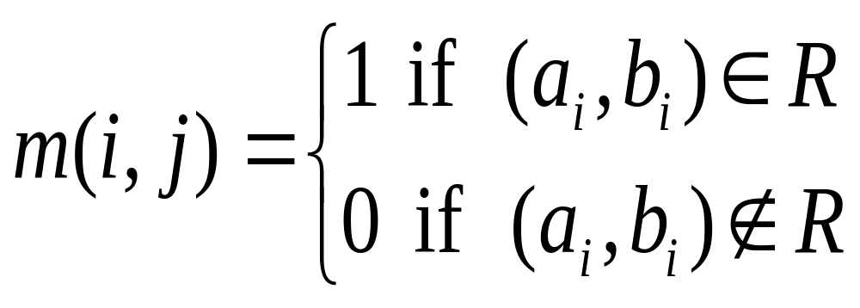
MATRIX REPRESENTATION OF A RELATION
  Let A = {a₁, a₂, …, a_{n}} and B = {b₁, b₂, …, b_{m}}. Let R be a relation from A to B. Define the n × m order matrix M by
for i=1,2,…,n and j=1,2,…,m

Slide 30
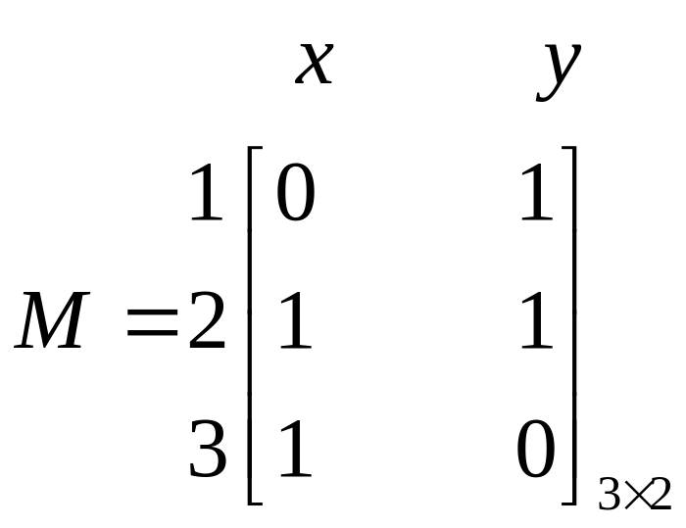
EXAMPLE
  Let A = {1, 2, 3} and B = {x, y}
  Let R be a relation from A to B defined as
  R ={(1,y), (2,x), (2,y), (3,x)}

Slide 31
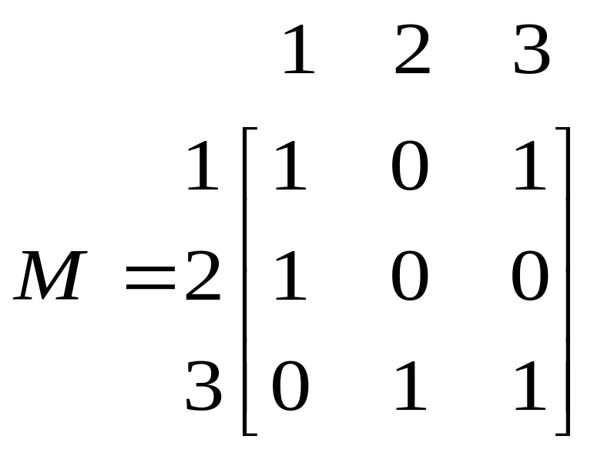
EXAMPLE
For the relation matrix.
  List the set of ordered pairs represented by M.
  Draw the directed graph of the relation.

Slide 32
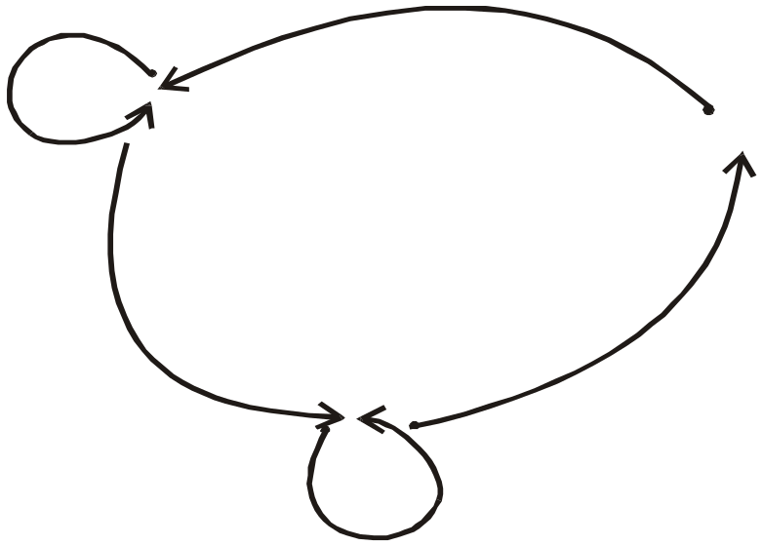
SOLUTION
  The relation corresponding to the given Matrix is
  R = {(1,1), (1,3), (2,1), (3,1), (3,2), (3,3)}
  And its Directed graph is given below
1
2
3

Slide 33
EXERCISE
  Let A = {2, 3, 5, 6, 8}
  The congruence modulo 3 relation T is defined on A as follows:
  for all integers m, n ∈A, m T n ⇔ 3 | (m – n)
  Write T as a set of ordered pairs.
  The directed graph representation.
  The matrix representation.

Slide 34
SOLUTION
  1.Note that 2 T 2 because 2-2=0 and 3⏐0.
  Also 2T5 because 2-5 = -3 which is divisible by 3.
  And 2T8 because 2-8 = -6 which is divisible by 3.
  Similarly, 3T3, 3T6, 5T2, 5T5, 5T8, 6T3, 6T6, 8T2, 8T5 and 8T8.
  Hence
  T = {(2,2), (2,5), (2,8), (3,3), (3,6), (5,2), (5,5), (5,8), (6,3), (6,6), (8,2), (8,5), (8,8)}

Slide 35
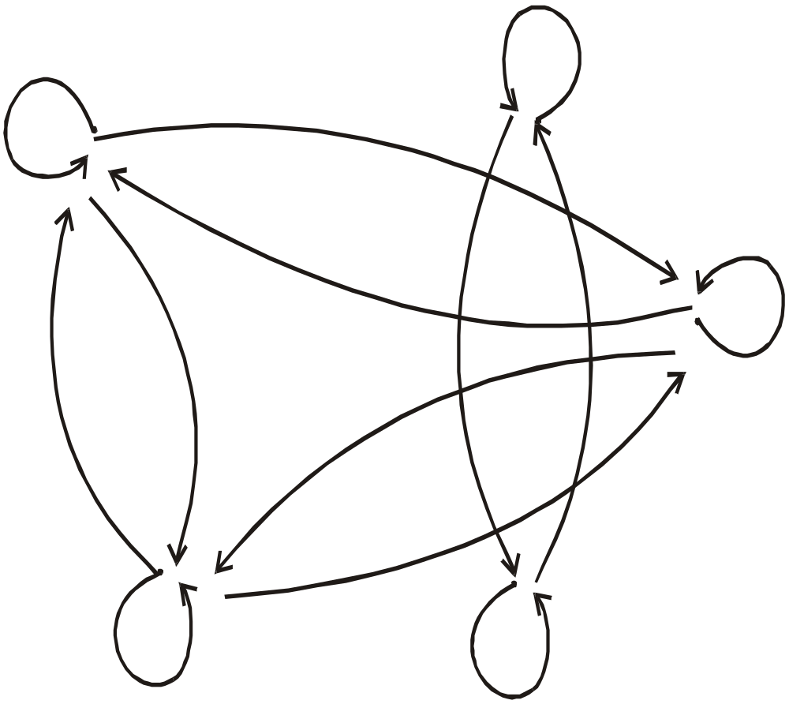
DIRECTED GRAPH AND
MATRIX REPRESENTATION
A = {2,3,5,6,8} and
T = {(2,2), (2,5), (2,8), (3,3), (3,6), (5,2), (5,5),(5,8), (6,3), (6,6), (8,2), (8,5), (8,8)}
3
2
5
8
6

Slide 36
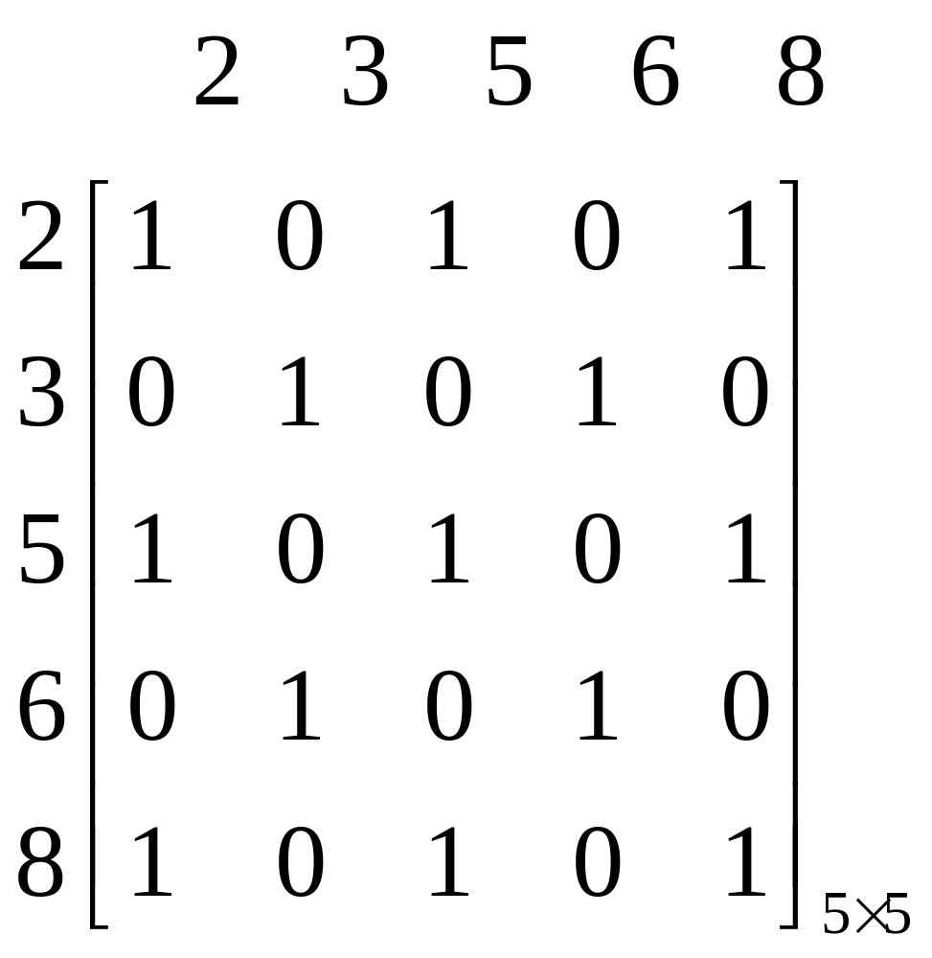
MATRIX REPRESENTATION

Slide 37
EXERCISE
  Define a binary relation S from R to R as follows:
  for all (x, y) ∈R×R,
  x S y ⇔ x ≥ y.
  Is (2,1) ∈ S? Is (2,2) ∈ S? Is 2S3? Is (-1) S (-2)?
  SOLUTION
  (2,1) ∈ S because 2 ≥1
  (2,2) ∈S because 2 ≥2
  2 S 3 because 2 ≥ 3
  (-1) S (-2) because -1≥ -2

Slide 38
EXERCISE
  Let A = {2, 4} and B = {6, 8, 10} and define relations R and S from A to B as follows:
  for all (x,y) ∈A × B,
  x R y ⇔ x | y
  for all (x,y) ∈A × B,
  x S y ⇔ y – 4 = x
  State explicitly which ordered pairs are in A × B, R, S, R∪S and R∩S.
  SOLUTION
  A × B = {(2,6), (2,8), (2,10), (4,6), (4,8), (4,10)}
  R = {(2,6), (2,8), (2,10), (4,8)}
  S = {(2,6), (4,8)}

Slide 39
  R = {(2,6), (2,8), (2,10), (4,8)}
  S = {(2,6), (4,8)}
  R ∪ S = {(2,6), (2,8), (2,10), (4,8)}
  R ∩ S = {(2,6), (4,8)}

